Slide 1
Exchange User Group {Online Edition}
29. April 2021

Slide 2
Meetup Q2 2021
Talk 1 - SmarterMail - An Enterprise-Ready alternative to Exchange Server Tim Uzzanti
Talk 2 - Exchange Server Mailbox Basics Martin Gudel

Slide 3
Exchange User Group

Slide 4

Exchange User Group
Organisatorisches
Nächster Termin: 19. August 2021
Homepage: https://exusg.de
Twitter: @exusg #exusg

Slide 5
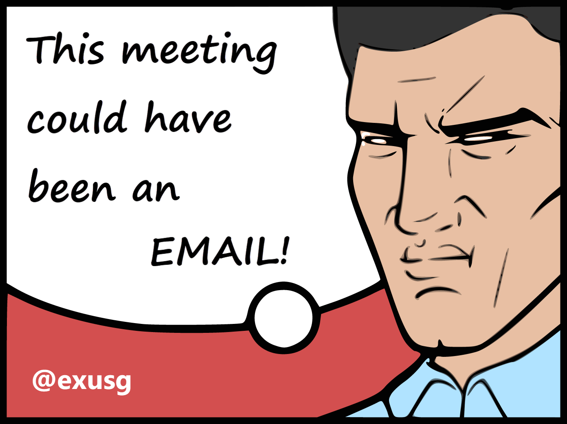
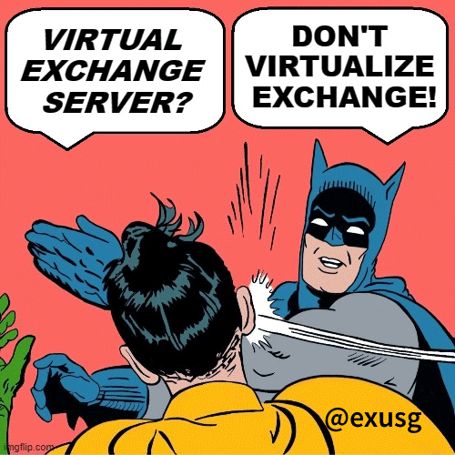
Exchange User Group
Organisatorisches
Exchange User Group Team
Im Microsoft Community Tenant
Community Sticker
https://go.granikos.eu/CommunitySticker
EXUSG-Logo Sticker in Kürze verfügbar
Sticker-Contest
Exchange Floskeln und Texte per DM an @exusg

